Slide 1

BEHAVIOR ANALYSIS OF CUSTOMER FOR A COMPANY 1010390
Hussein Aldahesh
Shukatullah Anwari
Ufuk Atmaca
Nejat Kerem Eralp
Hammam Hraesha
Emre Kütükçü
Advisors:
Alper Camcı
Pınar Sarısaray

Slide 2
Intro
This capstone project aims to analyze the impact of the COVID-19 pandemic on online shopping behavior from both a software engineering and management perspective. The project utilizes Python programming language for data preprocessing, analysis, and visualization. The k-means clustering algorithm is applied to identify patterns and clusters within the datasets. Additionally, a survey is conducted to gather insights from individuals on their online shopping habits during and after the pandemic.

Slide 3
Table of Content
Overview
Functional and Performance Requirements
About the Datasets and Analysis Techniques
Technologies and methods
Visuals of Gender Distributions
Visuals of K-means clustering
Findings
Survey Questions and the Logic Behind Them
Correlation analysis
Regression analysis
Conclusion
Result

Slide 4
Overview
Purpose of the project: Analyze the impact of the COVID-19 pandemic on online shopping behavior from both a software engineering and management perspective.
Problem we are trying to solve: Understand changes in online shopping behavior during and after the pandemic and identify key factors influencing consumer preferences.
Current research: Despite the risks online shopping that the customer are facing, it is still very popular and using on daily based
Approach: Utilize Python programming language for data preprocessing, analysis, and visualization. Apply k-means clustering algorithm to identify patterns and clusters in the datasets. Conduct a survey to gather insights from 199 individuals on their online shopping habits.

Slide 5
Functional and Performance Requirements
Functional requirements: Roles of Data Analyst, Data Scientist, and Machine Learning Engineer. Tools used: .csv files, Jupyter Notebook, Pandas, NumPy, Plotly, Matplotlib.
Performance requirements: Timely response, fast page rendering, efficient data visualization and processing.
Maintainability requirements: Backup plans, regular updates.
Usability requirements: Intuitive navigation, multi-language support.
Security and safety requirements: Robust password policy, data encryption, email account linking, database isolation.
Availability requirements: Compatibility with Mac and Windows/PC platforms.
Measures of effectiveness: Customer satisfaction, stakeholder satisfaction, project completion within budget and timeframe, retention rate, team performance.

Slide 6

Technologies and methods
The software engineering team will employ Python programming within the Jupyter Notebook IDE, which was accessed through the Anaconda package, to do data analysis on client behavior.
We kept our datasets in.csv files for easy access and administration.
To facilitate the analysis process, we made use of popular Python libraries such as Pandas, NumPy, Plotly, and Matplotlib
The analytical method was K-means clustering, an unsupervised learning algorithm often used for market segmentation.

Slide 7
About the Datasets and Analysis Techniques
Customer Dataset: Description of the dataset with 2000 records and 8 columns. Insights on customer profiles and their impact on purchase decisions.
Survey Dataset: Description of the dataset created with 213 entries and 29 columns. Insights on online shopping behavior during and after COVID-19.
Analysis techniques: ML model using k-means clustering algorithm for identifying patterns and clusters in the datasets.

Slide 8
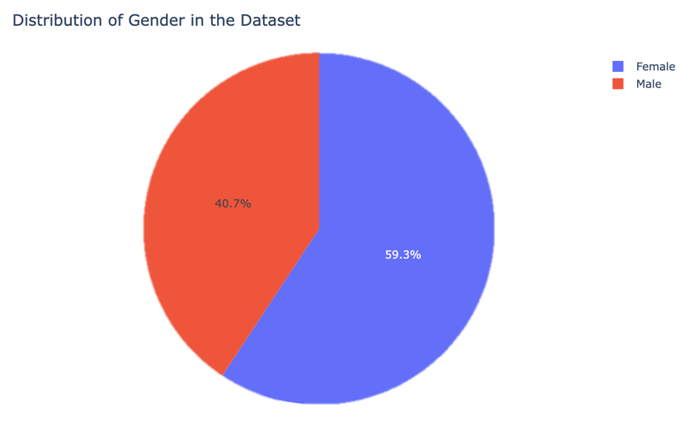
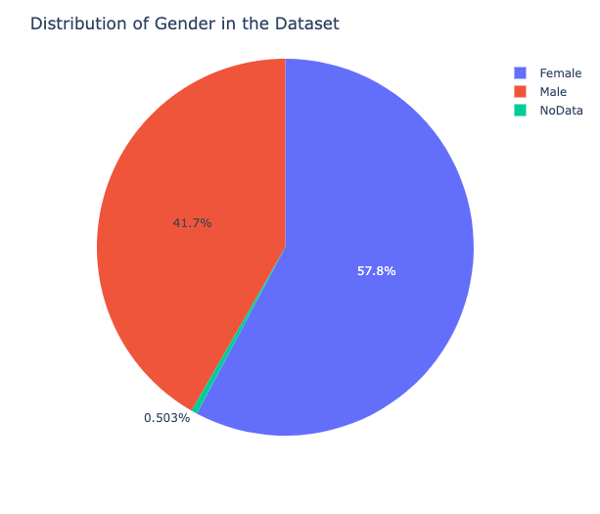
Visuals of Gender Distributions
Before Covid Dataset
After Covid Dataset

Slide 9
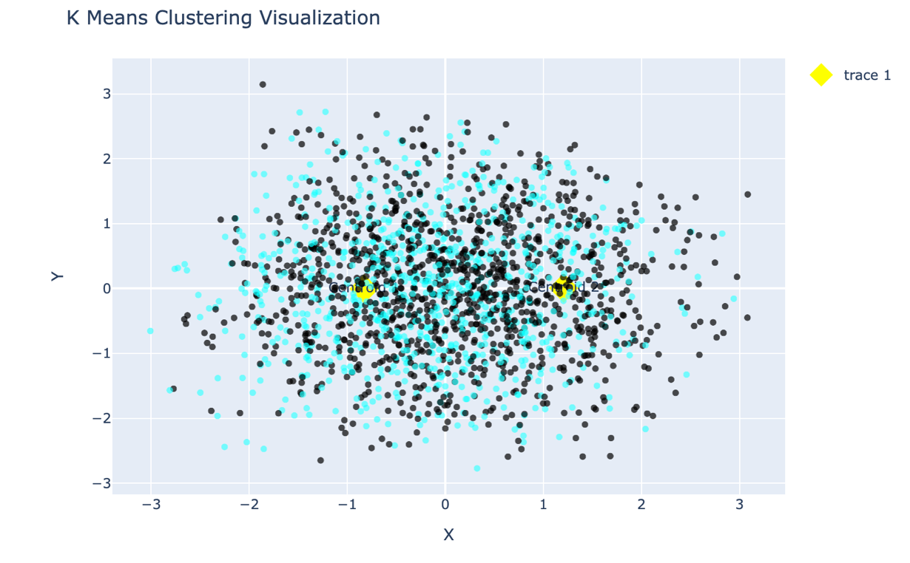
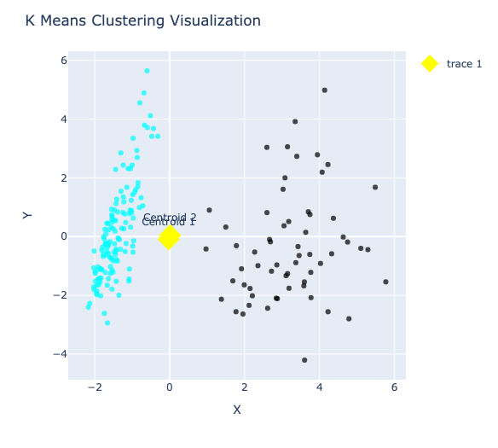
Visuals of K-means clustering
Before Covid Dataset
After Covid Dataset

Slide 10
Findings
The findings show a significant increase in online shopping during the COVID-19 period, with consumers relying more on online platforms. Factors such as trust in payment methods and personalized product recommendations are found to be important determinants of online purchasing behavior. These findings have implications for businesses in terms of software systems, decision-making processes, and marketing strategies. The project contributes to the understanding of online consumer behavior and provides insights for improving online marketing strategies.
In conclusion, this capstone project examines the effects of the COVID-19 pandemic on online shopping behavior from both software engineering and management perspectives. The project utilizes advanced programming tools and methodologies, along with survey data, to gain comprehensive insights into customer behavior. The results emphasize the importance of customer satisfaction, data-driven decision making, and adaptability in the online shopping landscape.

Slide 11
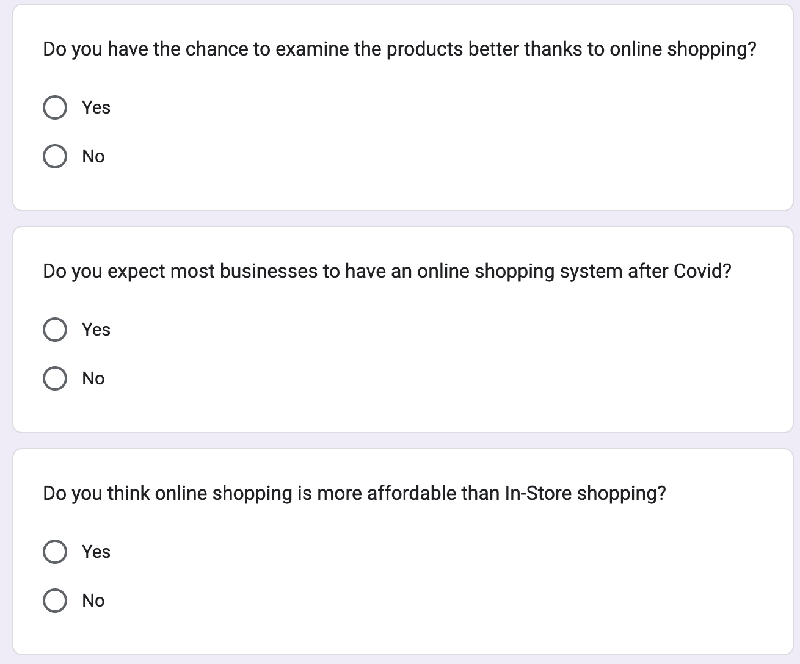
Survey Questions and the Logic Behind Them
Example of "Yes" No" Questions
These questions helped us eliminate the correct attenders of the survey since we asked them at the very beginning.
For example if a person says "no" to "do you shop online?" Question, that person's whole survery is to be eliminated and was took out from the results.

Slide 12
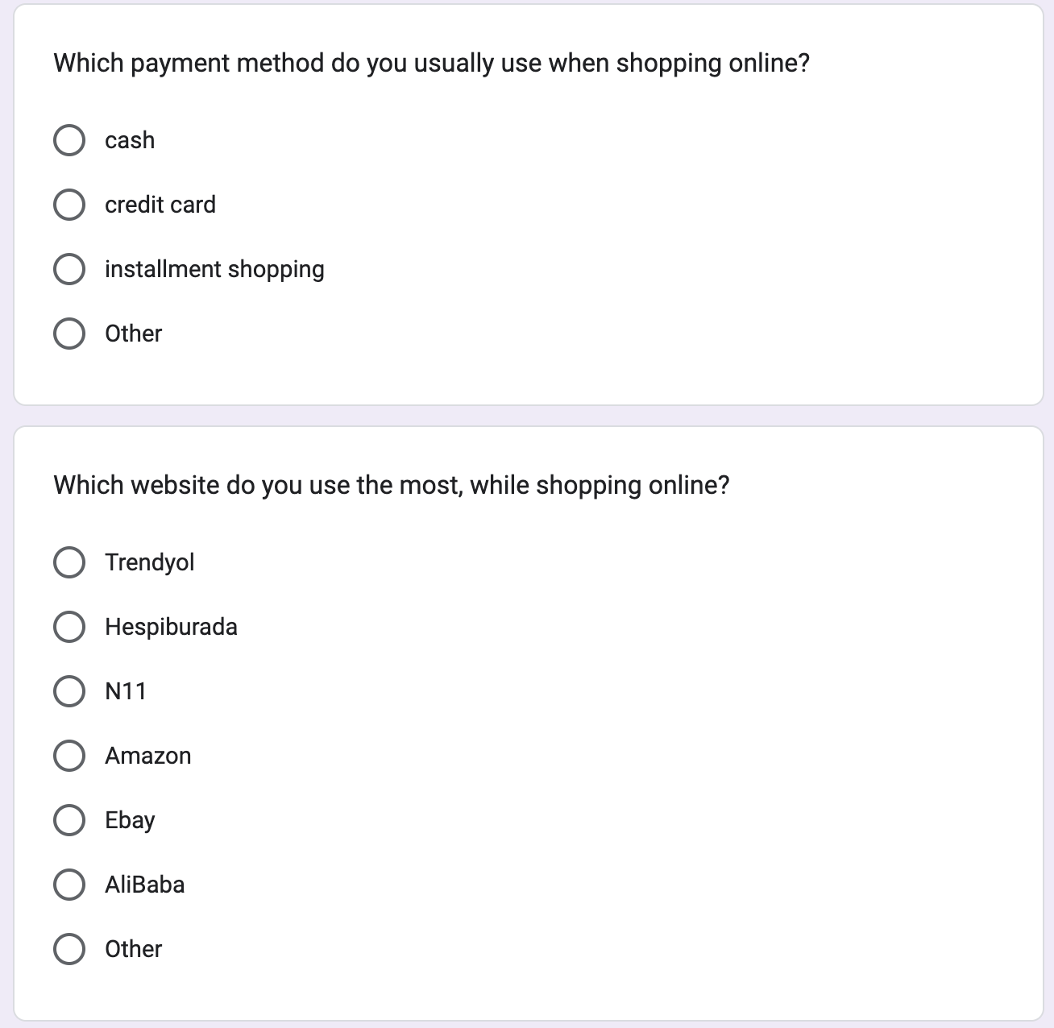
Example of "Multiple Choice" Questions
These questions were the main data collectors of our survery since it provides specific answers for specific questions and behaviours.
We tried to keep the survey not boring by giving the multiple choice questions in the midle part.

Slide 13
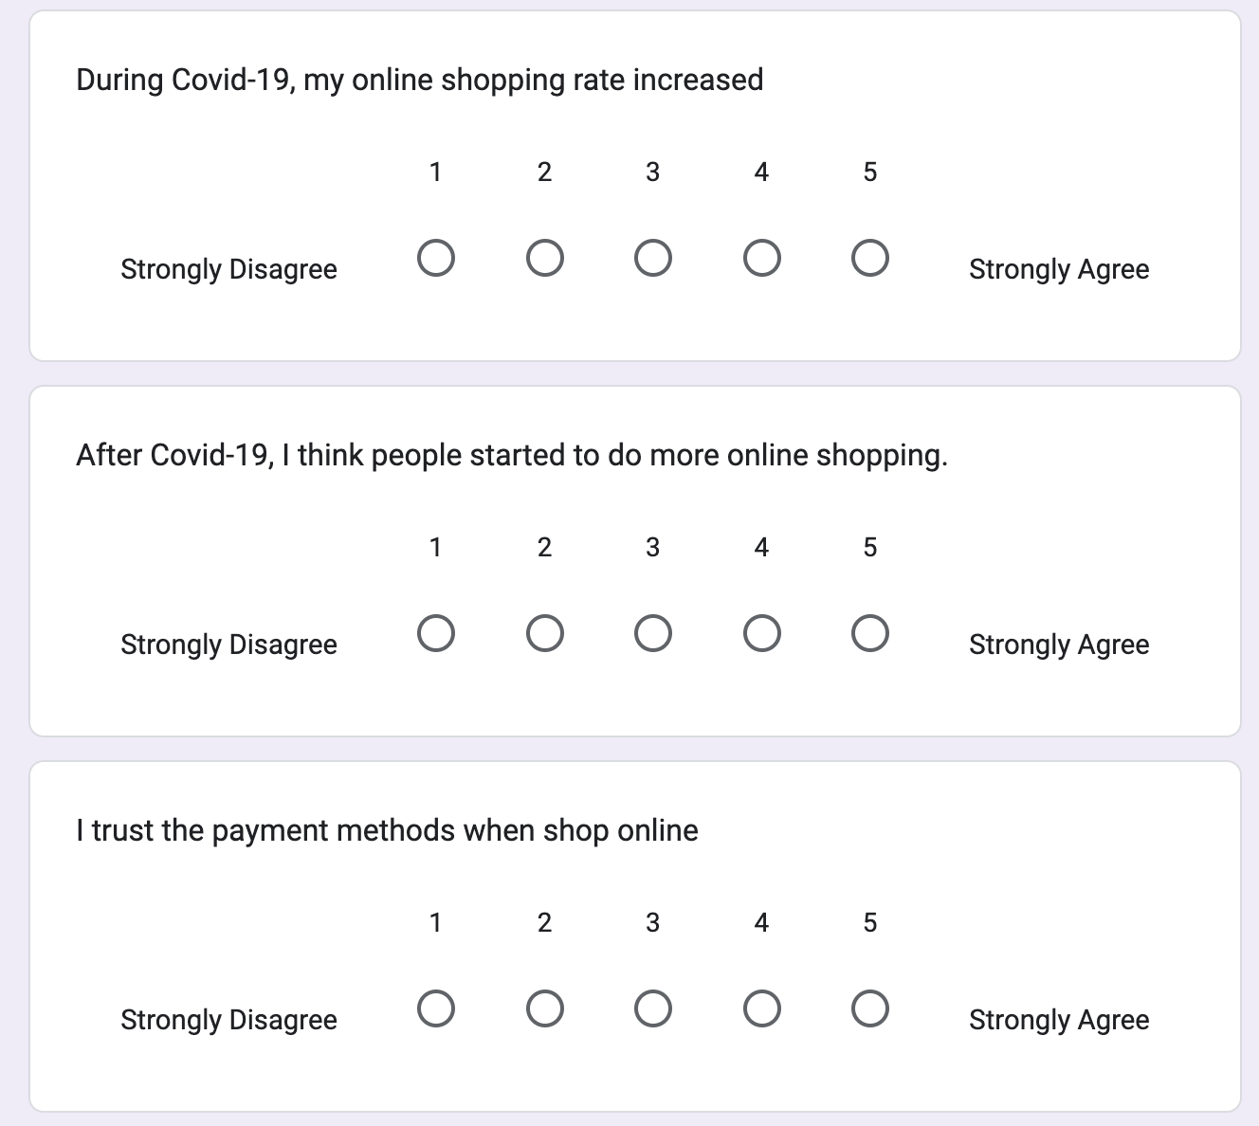
Example of "Scale" Questions
The Scaling questions gave us a quantiative data on the level of people's behaviours.
With the help of this data set, we were able to came to a conclusion about specific limits and the correlation analysis.

Slide 14
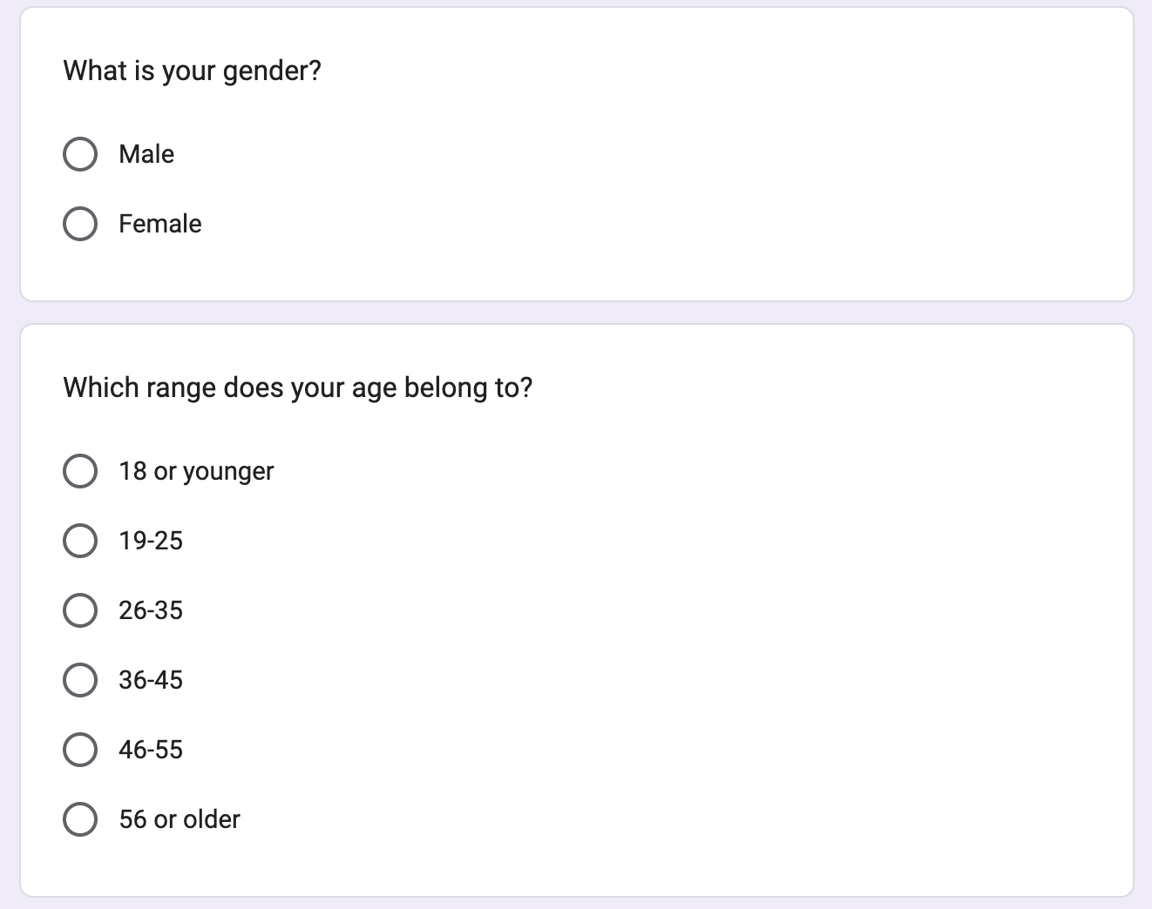
Example of "Demographic" Questions
Demographic questions were asked at the end to prevent boredom of the survey.
By asking these questions we were able to know some specific characteristics from gender to martial status of our sample.

Slide 15
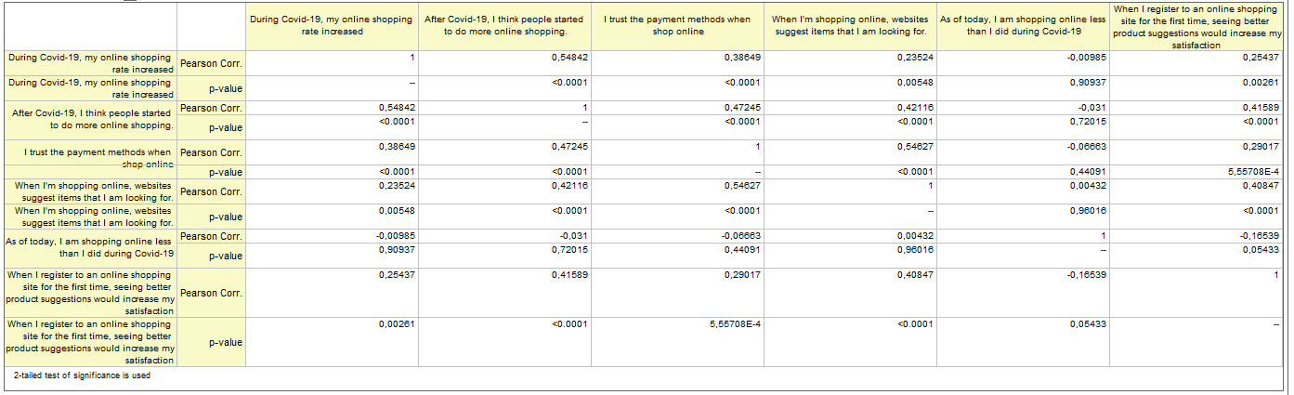
Correlation Analysis
The correlation analysis results can be seen on the table and with these results we tried to understand if there is a correlation or not.

Slide 16
Pearson Correlation = 0,54842
In the analysis part, we beginned with correlations that shows what people does and what they think others do. We found that there is a mid level of correlation. This correlation was important to understand how people behave and think.

Slide 17
Pearson Correlation = 0,47245
Pearson Correlation = 0,42116
On the other part of the analysis, we tried to find several correllations and gave informations about them.
Also we added some negative correlations.
At the end we found some results that supports our first ``PROBLEM`` part question.

Slide 18
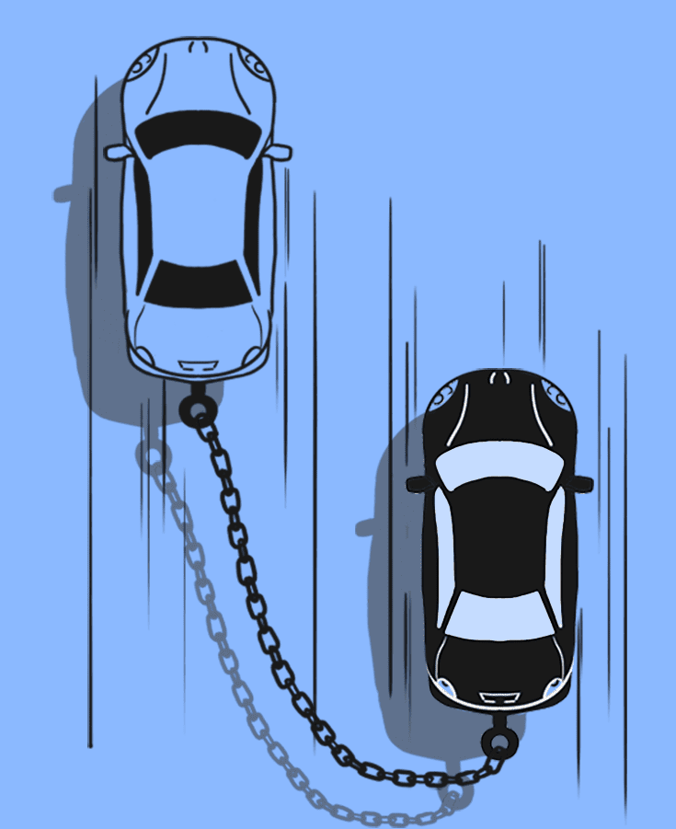
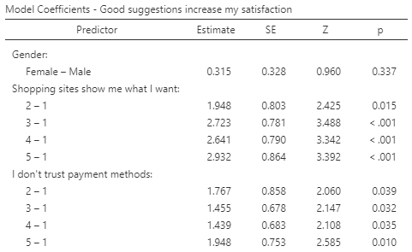
regression analysis
For the regression analysis we have used several types of regression to find correlation between multiple predictors as to see if there was a link to support our project. We have used Ordinal Logistic Regression Analysis and Binomial Logistic Regression Analysis for this purpose. We have started simple by using three predictors and increased the predictors too see which ones affected the dependable the most.
For example, we have found a good correlation a good fit.

Slide 19
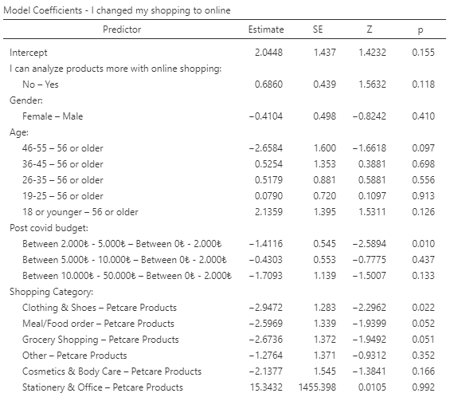
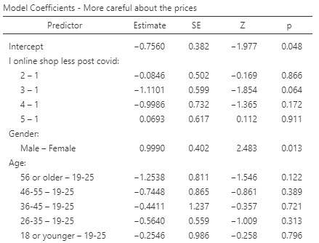
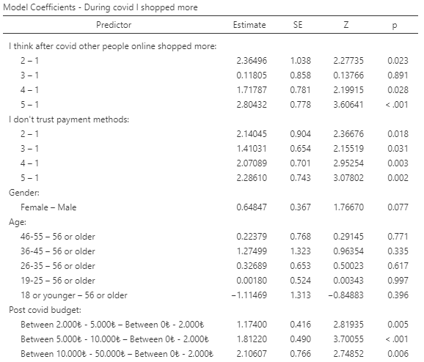
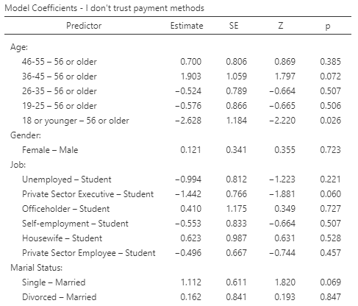
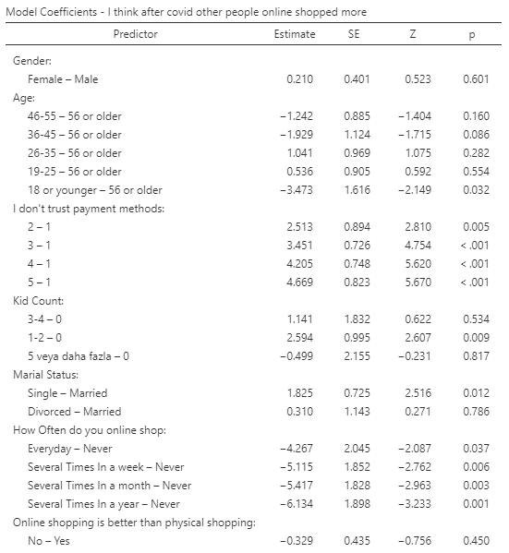
These are the other significant findings we have gathered in our analysis to support our project problem and predict the dependable.

Slide 20
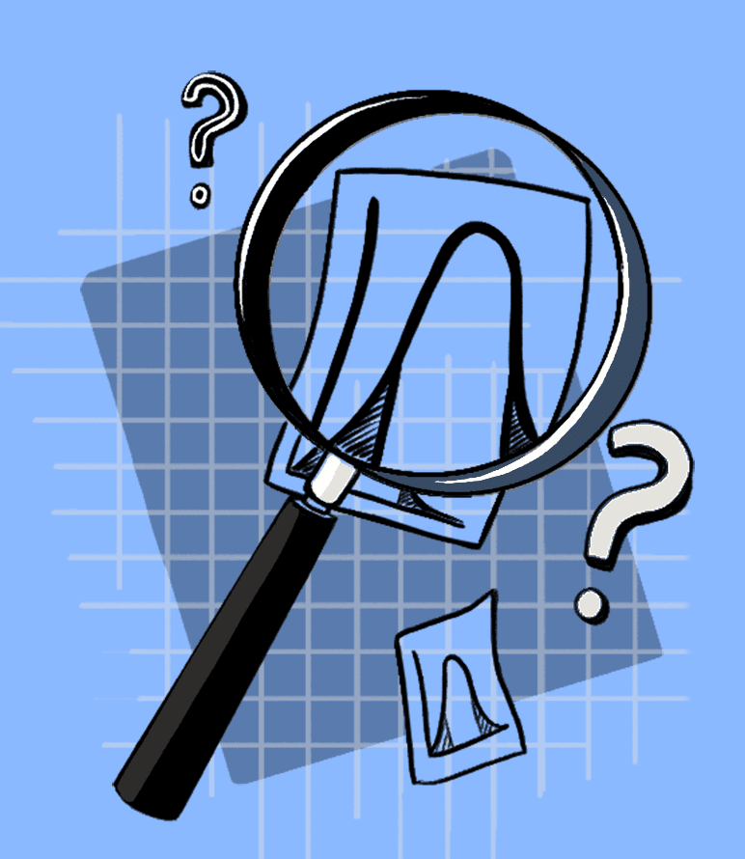
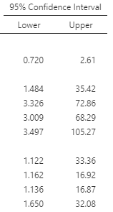
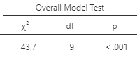
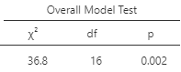
While also looking at the significance, we have also considered the goodness of fit in these data analysis and while there were variations, we have compared Pseudo-R squared, we have used McFadden’s, Cox and Snell’s and Nagelkerke’s R squared and tried for each table. As we know a parameter by itself does not always generate a fruitful conclusion therefore, we must take P, Pseudo, BIC values, confidence intervals and more points into consideration.

Slide 21

CONCLUSION
In today’s world online shopping is more popular than ever before. In the last 10 years, the rate of online shopping has boomed. In this time period there were many reasons behind the increased rate of online shopping.
The Covid-19 era was one of them and it affected human life in many ways. This change was so big that it even affected the habit of online shopping. In order to understand Covid-19 effects on online shopping, we conducted a survey that was prepared by scientific techniques and shared this survey with 153 different people. There were variety of ways to analyze the data we have in our dataset, and we have applied multiple analysis methods in addition to our machine learning system and gathering multiple minds for the same goal.

Slide 22

result
As a result of all the analysis methods we used, we saw that the covid-19 period contributed positively to online shopping and this contribution continued after covid-19. We can see that the majority of those who started online shopping during the covid-19 period still continue to use it.
Our results show that trusting the payment method also positively affected the online shopping at the covid-19 era. When we also look at the analysis part, we can see those trusting payments positive effect got bigger after covid-19, and it has little more impact on online shopping after covid-19.

Slide 23

For the last part, we can say that better product suggestions on shopping websites may increase the satisfaction.
It is a possiblity becuase we have observed that in some answers we can say that it increases, but on the other hand some answers show us that people believe that it increases other people’s satisfaction more than their own.
The companies can use our research findings in every aspect of their work departments and processes to find new opportunities in their industries.
At the end, shopping should be open to more innovative ideas in order to optimize the enhancement of the marketing practices they have used for a long time.

Slide 24

Thanks

